Slide 1
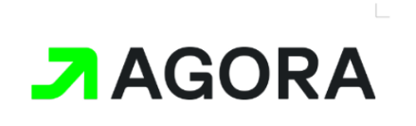

AGORA Teamcenter
Agora Teamcenter Gateway
Enabling Integration with External Applications
AGORA Teamcenter Team
August 2024

Slide 2
Contents
Agora Teamcenter Gateway
Introduction – Purpose
High-level Architecture
Operating Modes – Real-time and Publish/Subscribe Model
Security Considerations
Standard Use Cases
Technologies/Platforms/Tools Proposed
Next Steps

Slide 3




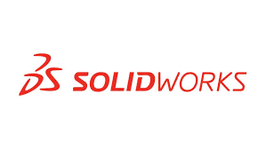





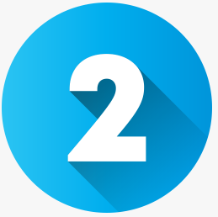

Introduction
What is AGORA Teamcenter Gateway?
AGORA Tc Gateway enables applications like JAMMEX, Key Cloak act as a SINGLE POINT OF CONTACT (SPOC) to communicate with AGORA Teamcenter
1) Realtime basis and 2) Near Realtime – Publish Subscribe Model
CAD-DATA , META-DATA, PART-DATA, DATASETS etc from AGORA Tc can be Shared (PRE-Released State)
Teamcenter ADMIN Related Functions can be Performed (UserADD, UserMODIFY, UserREMOVE etc)
External Apps
AGORA Tc Gateway
Teamcenter Instances
CAD
Tools
CREO/SolidWorks/Nx - Data Supported
Supports Multiple Security Models Recommended by Siemens
Multi-tier with Secured Communication Protocol (HTTPS)
Multi-tier with Client Authentication using Single Sign-on (Teamcenter Security Service)
Multi-tier with Client Authentication using Forward/Reverse Proxy (Teamcenter Client Communication System)
Can be leveraged to integrate with PDSS
To collect POST PRE-RELEASED State of PART’s CAD-DATA, META-DATA etc
Shall support Bulk Exports/Imports from/to between AGORA Tc and PDSS Tc

Slide 4

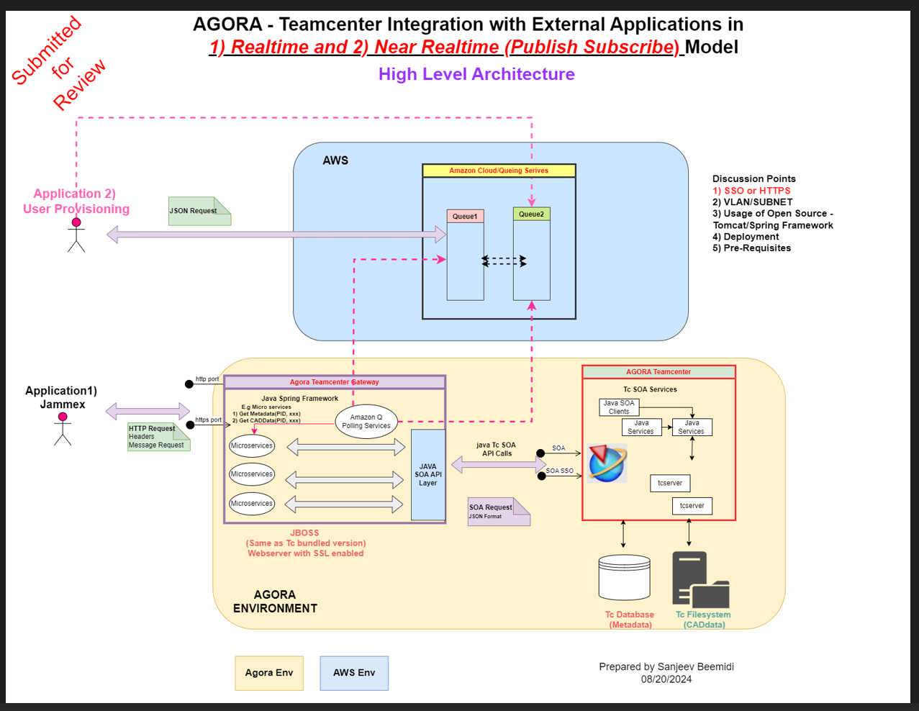
High-level Architecture
Key Features
AGORA Teamcenter Gateway – Uses Microservices Architecture/Framework for Optimal Scalability, Easier Fault Isolation, Loosely Coupled and Distributed Architecture.
To avoid tightly coupled API’s, designed to accept HTTP Request with Headers/Body consisting of Input Requests/Output Response – This enables a Standard Protocol for external applications
Two Modes – Realtime and Publish/Subscribe Models
Multiple Microservices – as appropriate to handle multiple requests (GetPartStatus, GetCADData, GetMetaData….)
Scheduler to Pull/Push Requests/Response from Amazon SQS
Internally uses Teamcenter Java based Services Based Requests/Response (SOA)
Supports Multiple Security Models Recommended by Siemens (Https, SSO and Forward/Reverse Proxy)

Slide 5

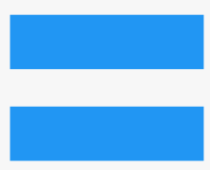

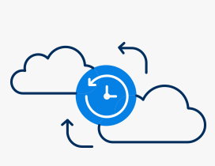
Operating Modes
ALL MODES COVERED
(1) Real-time Mode
Immediate Data Exchange: Enables instant synchronization between Agora Teamcenter and external applications.
Use Case: Ideal for scenarios requiring live updates and quick data processing.
(2) Publish/Subscribe Mode
Poller Component Scheduled/Monitoring: Data is processed and shared based on specific events.
Use Case: Fire and Forget, Asynchronous Modes etc

Slide 6
Security Considerations 3 Modes supported by Teamcenter
The Gateway Confirms to all Security Requirements for AGORA Project Security Guidelines
Teamcenter offers following 3 modes of security considerations when it comes to communication between client and Server.
Multi-tier with Secured Communication Protocol (HTTPS)
Multi-tier with Client Authentication using Single Sign-on (Teamcenter Security Service)
Multi-tier with Client Authentication using Forward/Reverse Proxy (Teamcenter Client Communication System)
AGORA Teamcenter Uses – Approved Software's/Framework for Design/Development
Siemens Recommended Security Models
Https
SSO
Forward/Reverse Proxy
REFERENCE : Siemens Deployment Reference Architecture Document

Slide 7
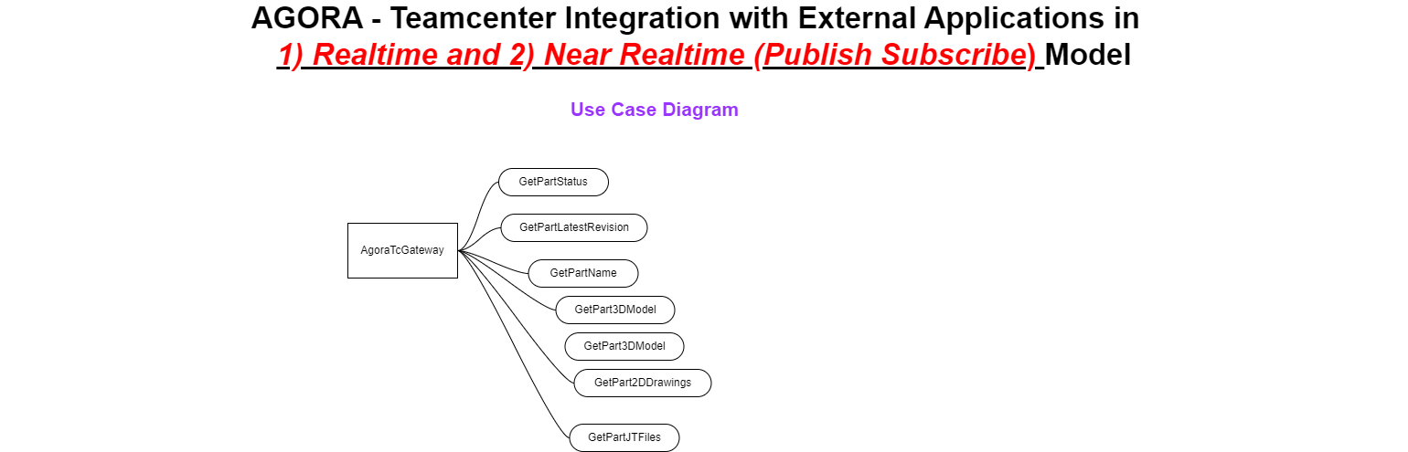
Standard Use cases
Integration: Typical Use cases shall be developed from various roles/groups perspective
Role Perspective
Data Perspective
Use Case 1: Part Metadata Retrieval:
Scenario: JAMMEX requests metadata such as part name, part status and revision details.
Response: JSON format with detailed metadata.
Use Case 2: CAD Data Access:
Scenario: External systems request 3D models, JT files, or 2D drawings.
Response: Direct download links for the requested files. (Based on business Requirement we can finalize how to share Design Files to users.)
Use Case 3: Key Cloak:
Scenario: Provision new users in Teamcenter via an asynchronous SQS request.
Response: Status updates and confirmation upon completion.
Engineer: Interacts with the system to retrieve design-related data (e.g., 3D Models, 2D Drawings, JT Files, Geometry).
Procurement Officer: Requests information on technical specifications and preferred vendors.
Quality Inspector: Uses the system to retrieve JT files for analysis.
Project Manager: Checks the owner, release status, and release date of parts.
Government Contractor: Requires CAGE code for parts.

Slide 8
Proposed Technologies
Technologies:
Java Spring Framework: Core framework for developing the gateway.
AWS SQS: Message queuing service for asynchronous communication.
JBOSS: SSL-enabled web server for deploying microservices.(Siemens Installmedia for Teamcenter bundled with JBOSS)
Platforms:
Teamcenter: Centralized PLM system.
Agora Environment: Encompasses the Teamcenter Gateway and related services.
Tools:
Git/SVN: Version control for code and configuration management.
Teamcenter APIs: For interfacing with Teamcenter services.

Slide 9
Next Steps
1. Finalize Architecture Review
Complete the initial review of the architecture to ensure alignment with AGORA’s overall design.
2. Develop Proof of Concept (PoC)
Begin development of the PoC to validate the integration solution’s feasibility and effectiveness.
3. Execute Comprehensive Testing
Implement unit, integration, and end-to-end testing across all environments to ensure functionality, performance, and security.
4. Implement MVP
Develop and deploy the Minimum Viable Product (MVP) focusing on the core integration processes.
5. Plan for Future Enhancements
Outline the roadmap for future scalability, updates, and integration expansions based on real-world feedback.

